Slide 1
SC Theory 27th April 2018
Huy-Hung Ho
Key Laboratory for Smart Integrated Systems (SISLAB),
VNU University of Engineering and Technology (VNU-UET)

Slide 2
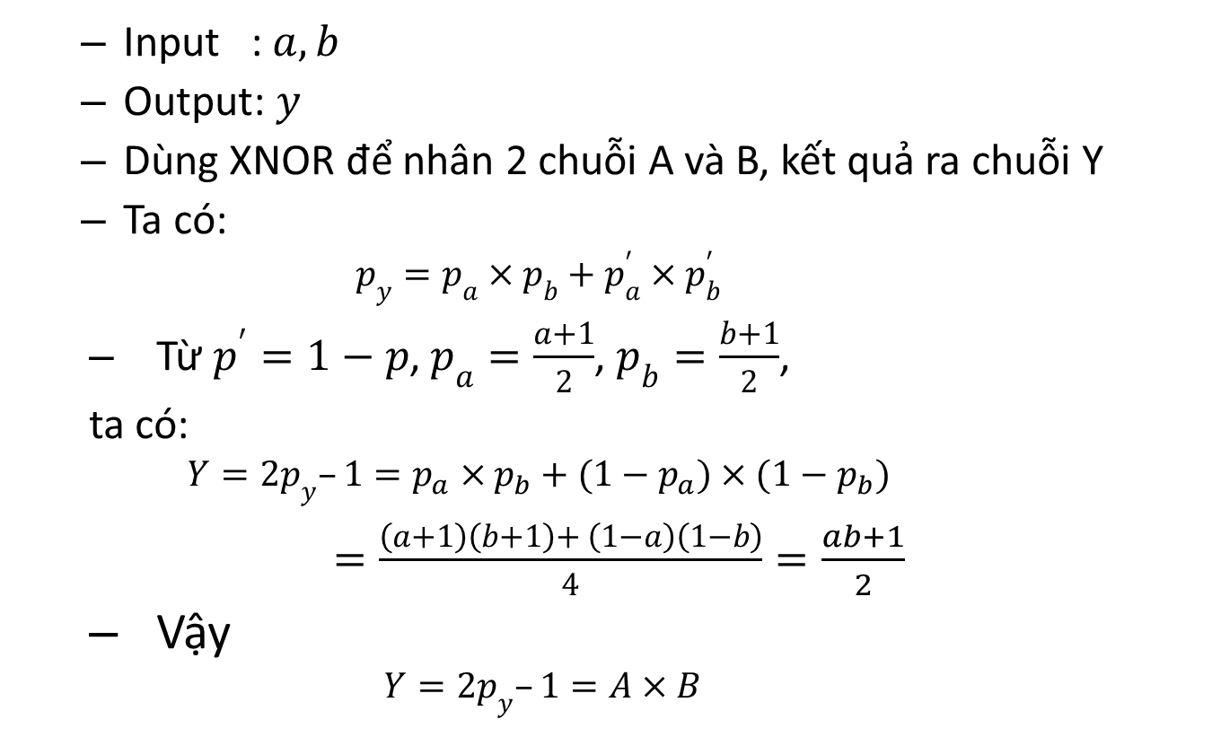
Background: SC Multiplication
Input : $a, b$
Output: $y$
Dùng XNOR để nhân 2 chuỗi A và B, kết quả ra chuỗi Y
Ta có:
$$p_{y}=p_{a}×p_{b}+p_{a}^{′}×p_{b}^{′}$$
Từ $p^{′}=1−p$, $p_{a}=\frac{a+1}{2}$, $p_{b}=\frac{b+1}{2}$,
ta có:
$$Y=2p_{y}–1=p_{a}×p_{b}+(1−p_{a})×(1−p_{b})$$
$=\frac{\left(a+1\right)\left(b+1\right)+ \left(1−a\right)\left(1−b\right)}{4}=\frac{ab+1}{2}$
Vậy
$$Y=2p_{y}–1=A×B$$

Slide 3















Kiến trúc nơ-ron SC
$$clk$$
$$reset$$
$$activ$$
$$clear$$
Activation function
$$b$$
$$output$$
$$x_{1}$$
SNG1
$$w_{1}$$
SNG1’
$$x_{2}$$
SNG2
Binary Adder Tree
$$w_{2}$$
Counter
SNG2’
$$\frac{\sum_{i=1}^{M}{x_{i}×w_{i}}}{M}$$
$$x_{M−1}$$
T
Q
$$w_{M−1}$$
SNGM-1
Q’
SNGM-1’
$$x_{M}$$
SNGM
(Adder component)
$$w_{M}$$
SNGM’
Bipolar

Slide 4
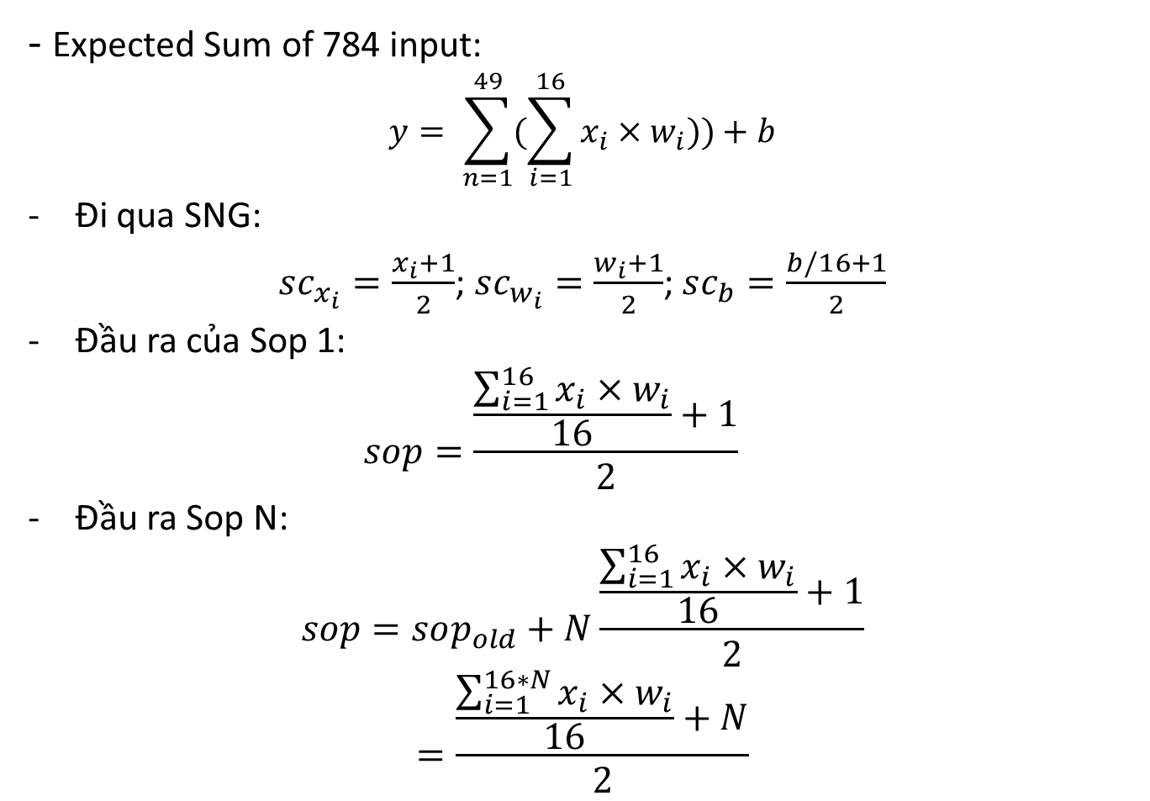
Nơ-ron SC
- Expected Sum of 784 input:
$$y= \sum_{n=1}^{49}{(\sum_{i=1}^{16}{x_{i}×w_{i}}))+b}$$
Đi qua SNG:
$sc_{x_{i}}=\frac{x_{i}+1}{2}$; $sc_{w_{i}}=\frac{w_{i}+1}{2}$; $sc_{b}=\frac{b/16+1}{2}$
Đầu ra của Sop 1:
$$sop=\frac{\frac{\sum_{i=1}^{16}{x_{i}×w_{i}}}{16}+1}{2}$$
Đầu ra Sop N:
$$sop=sop_{old}+N\frac{\frac{\sum_{i=1}^{16}{x_{i}×w_{i}}}{16}+1}{2}$$
$$=\frac{\frac{\sum_{i=1}^{16∗N}{x_{i}×w_{i}}}{16}+N}{2}$$

Slide 5


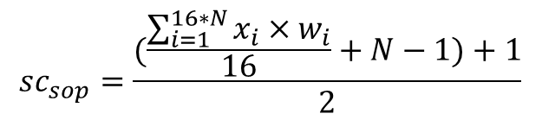
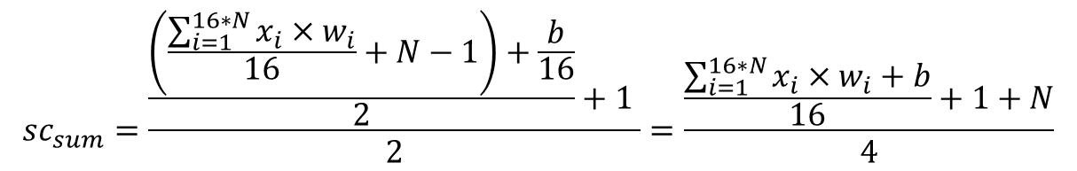
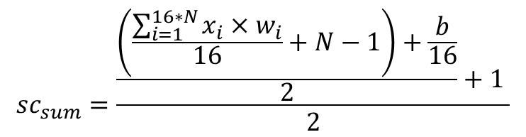

Sum = Sop + b
$$sc_{sop}=\frac{(\frac{\sum_{i=1}^{16∗N}{x_{i}×w_{i}}}{16}+N−1)+1}{2}$$
$$sc_{sum}=\frac{\frac{\left(\frac{\sum_{i=1}^{16∗N}{x_{i}×w_{i}}}{16}+N−1\right)+\frac{b}{16}}{2}+1 }{2}$$
$$sc_{b}=\frac{\frac{b}{16}+1}{2}$$
$$0.5$$
$$sc_{sum}=\frac{\frac{\left(\frac{\sum_{i=1}^{16∗N}{x_{i}×w_{i}}}{16}+N−1\right)+\frac{b}{16}}{2}+1 }{2}=\frac{\frac{\sum_{i=1}^{16∗N}{x_{i}×w_{i}}+b}{16}+1+N}{4}$$
$$sum=\sum_{i=1}^{16∗N}{x_{i}×w_{i}}+b=16×(4×sc_{sum}−1−N)$$

Slide 6
THANKS FOR YOUR ATTENTION

